Slide 1
PSYC 121, Week 2
Describing data

Slide 2
Evidence in psychology
"In listening to stories we tend to suspend disbelief in order to be entertained, whereas in evaluating statistics we generally have an opposite inclination to suspend belief in order not to be beguiled.”
John Allen Paulos, in Stories vs. statistics, New York Times, 24 October 2010

Slide 3
Central tendency
Mean, median and mode
Each of them can be useful
Each describe something potentially meaningful about a sample or a population
One their own, they don’t tell the whole story…

Slide 4
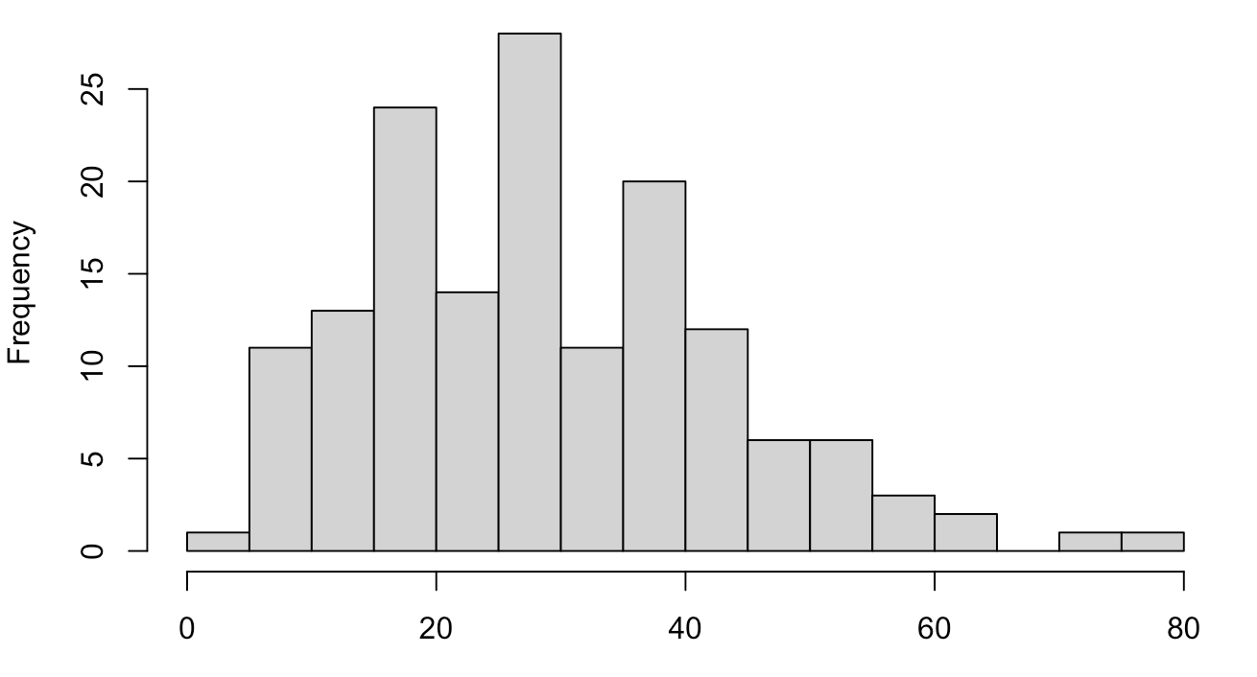
The importance of variability
What percentage of the UK population do you think are immigrants to this country (i.e. not born in UK?)
Mean estimate (PSYC121 cohort): 30%
Mean estimate (UK population): 24%
Actual value: 14%

Slide 5
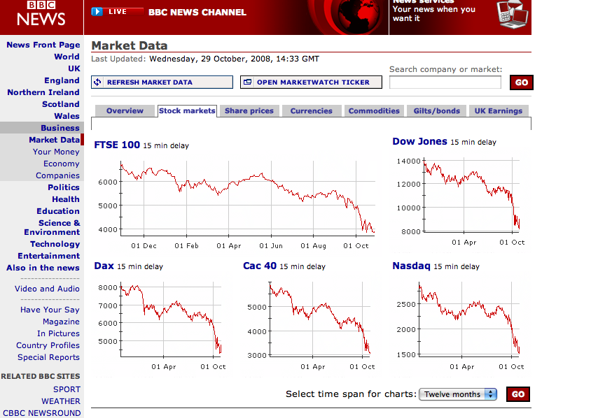
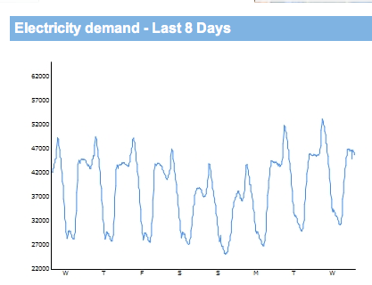
Illustrations of variability

Slide 6
Expressing variability
Visual depiction of variability
The amount of spread
The shape of spread
Numerical information about variable

Slide 7
Ways to assess variability
Range as a measure of variability
The inter-quartile range and semi-inter-quartile range.
Both of these are affected by extreme scores
Deviation is the distance from the mean: X –M
The mean deviation must be always be zero!
Therefore, we square the deviations
Variance is the mean squared deviation
Standard deviation = √ (variance)

Slide 8
Variability (in words)
Variance tells you how spread out the scores are around the mean
Standard deviation is (roughly) the average amount that scores differ from the mean

Slide 9
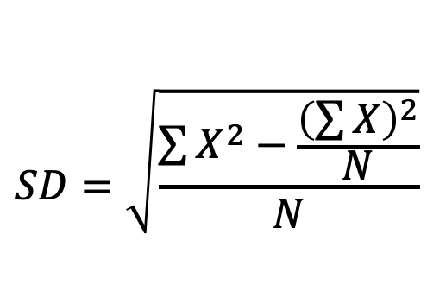
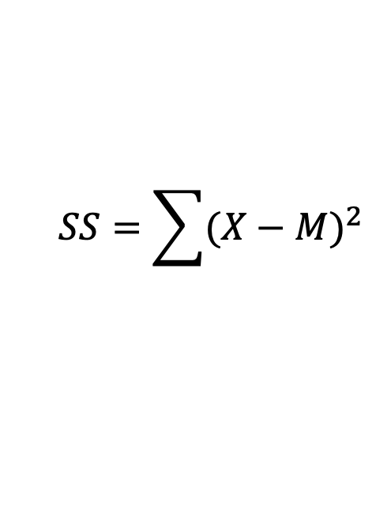
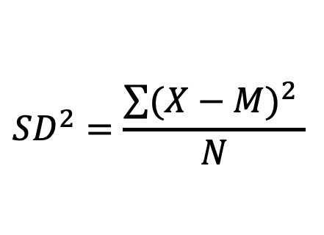
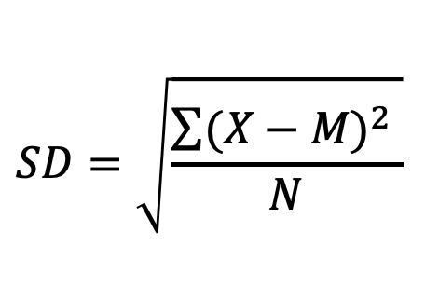
Aspects of variability (as calculations)
$$SS=\sum{{(X−M)}^{2} }$$
“Sum of Squares” =
$${SD}^{2}=\frac{\sum{{(X−M)}^{2} }}{N}$$
variance = SD²
$$SD=\sqrt{\frac{\sum{{(X−M)}^{2} }}{N}}$$
standard deviation = √ SD²
An alternative way of saying the same thing (computational formula)
$$SD=\sqrt{\frac{\sum{X^{2}}−\frac{{\left(\sum{X}\right)}^{2}}{N}}{N}}$$

Slide 10
Calculating the standard deviation
Find the standard deviation for the scores:
8, 6, 6, 9, 6, 5, 6, 2
Notes:
IN SPSS, but….

Slide 11
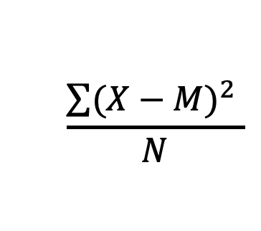
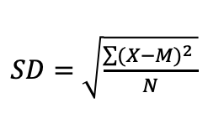
Calculating the standard deviation
Scores
Deviation
Deviation²
8
2
4
$$\frac{\sum{{(X−M)}^{2} }}{N}$$
6
0
0
6
0
0
9
3
9
3.75
6
0
0
5
-1
1
$SD=$ $\sqrt{\frac{\sum{{(X−M)}^{2} }}{N}}$
6
0
0
2
-4
16
1.94
48
Mean = 6
SS=30
SS = 30

Slide 12
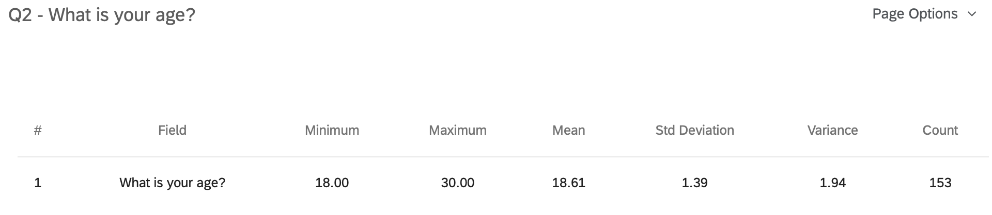
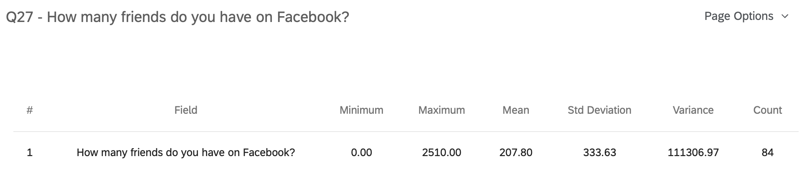
Example data

Slide 13
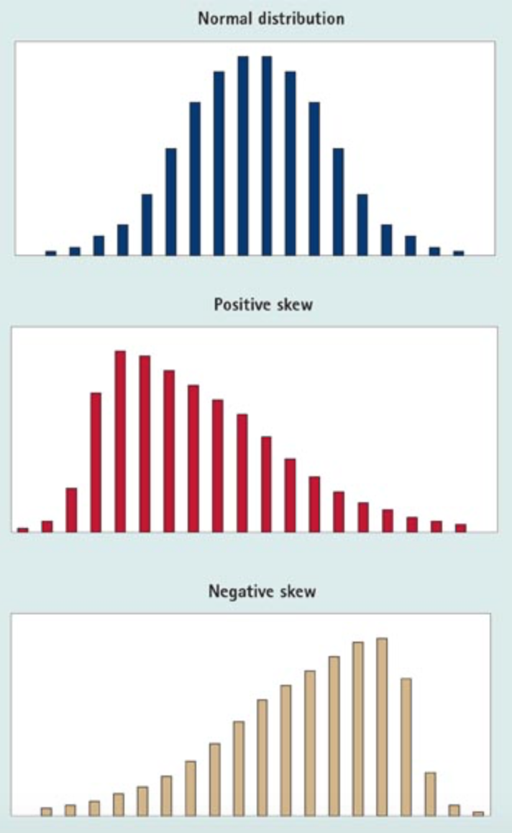
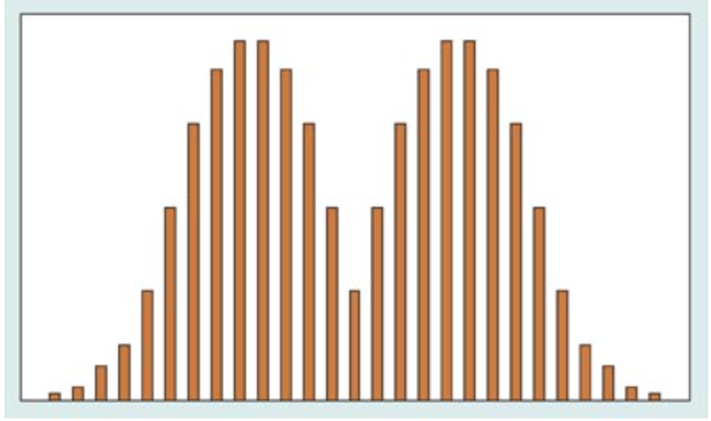
Variance and distributions

Slide 14
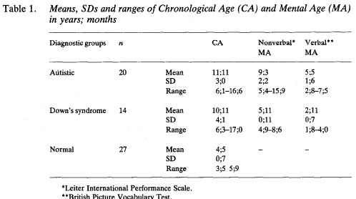
Interpreting the standard deviation
Baron-Cohen, Leslie & Frith (1985)
Studied whether children with autism could distinguish between knowledge and false belief
Tested 20 children with autism, 14 children with Down’s syndrome and 14 typically-developing children

Slide 15
Summary
Central tendency describes representative values
Different types of central tendency measure
Ask yourself which is better in the circumstances
Variability describes the spread of scores
Variability is important
It can be calculated in different ways
‘Standard deviation’ is a vital measure of variability

